Slide 1
Airbnb Data Challenge
Understand data & sanity check
Key metrics to monitor guest-host matching success
Feature engineering & Model building
Segments doing well v.s. not well
Opportunities in increasing the number of successful bookings
Challenges of matching supply and demand
Additional research methods
Notes:
Title less technical

Slide 2
Understand Data
&
Sanity Check

Slide 3
Overview of Datasets
Contacts:
There are 27,887 unique inquiries with 11,588 bookings, 14 variables
Inquiries are made through 3 channels: Contact me, Book it, and Instant book
The inquiry time varies from 01/01/2016 to 06/30/2016, lead time of these inquiries ranges from 0 - 803 days
The check in dates varies from 01/01/2016 to 05/01/2018, and length of stay ranges from 1 - 365 days
Inquiries are made by either new bookers or past bookers for 1 - 16 guests
The total number of interactions between guest and host ranges from 1 - 410
Listings:
There 13038 unique listings with 4 variables
There are 3 room types for listings: Entire home/apt, private room and shared room
Listings are located in 68 neighborhoods
The number of reviews for listings ranges from 0 -268
Users:
There are 31457 users after dropping 68 duplicated ones, with 3 variables
Users are from 121 unique countries with profile length ranges from 0 - 1442

Slide 4
Sanity Check - Assumptions
Contacts
Inquiry/reply/accept/book timestamps:
ALL channels:
Inquiry time ≤ reply time ≤ accept time ≤ book time
All accepted inquiries must be replied
All booked inquiries must be accepted
Check in time ≤ check out time
Book it:
Accept time = book time
Instant book:
Inquiry time = reply time = accept time = book time
Guest size ≥ 1, total number of interactions ≥ 1, and message length ≥ 0
Listings:
Number of reviews ≥ 0
Users:
No duplicated users
Profile length ≥ 0

Slide 5
Sanity Check - Observations and Treatments
Contacts
Inquiry/reply/accept/book timestamps:
ALL channels:
452 inquiries where the inquiry time > reply time with lags between 1-70 seconds
Updated the reply time to be the same as inquiry time
Book it:
257 inquiries accepted but not booked,
Updated the book time to be the same as accept time
152 inquiries where booked but not accepted or book time ≠ accepted time
Updated the book time to be the same as accept time
Instant book:
40 inquiries where inquiry, reply, accept, and booking did not happen at the same hour (allowed the latency of an hour)
Filtered out these inquiries assuming they are erroneous records

Slide 6
Sanity Check - Observations and Treatments (Cont.)
Contacts:
Guest size:
4 inquiries where number of guests is 0:
Filtered out these inquiries assuming they are erroneous records
Listings:
Number of reviews:
41 listings with negative number of reviews:
Replaced with medium
Users:
Duplicates:
68 users with duplicate ids:
Remove from analysis

Slide 7
Merge Data
Guest information:
Merged guest information from ‘Users’ to ‘Contacts’, by ‘id_guest_anon’ in ‘Contacts’ and ‘id_user_anon’ in ‘Users’
Host information:
Merged host information from ‘Users’ to ‘Contacts’, by ‘id_host_anon’ in ‘Contacts’ and ‘id_user_anon’ in ‘Users’
Listing information:
Merged listing information from ‘Listings’ to ‘Contacts’, by ‘id_listing_anon’ in both datasets

Slide 8
Overview of Data After Cleaning
Before/After | Inquiries | Replied | Accepted | Booked
Contact me | 12,828/12,814 | 11,659/11,645 | 5,482/5,476 | 911/909
Book it | 8,366/8,352 | 7,503/7,492 | 4,240/4,237 | 3,983/3,980
Instant book | 6,693/6,682 | 6,693/6,682 | 6,693/6,682 | 6,693/6,682
Total | 27,887/27,848 | 25,855/25,819 | 16,415/16,395 | 11,587/11,571
27,848 valid inquiries were made by 22,540 unique guests
The inquiry time varies from 01/01/2016 to 06/30/2016
Inquiries were made for 12,812 unique listings of 8,956 unique hosts

Slide 9
Key metrics to monitor guest-host matching success

Slide 10
Key metrics to monitor guest-host matching success
Reply/acceptance rate/booking rate
Reply rate = # inquiries replied/# total inquiries
Acceptance rate = # inquiries accepted/# total inquiries
Booking rate = # inquiries booked/# total inquiries
These metrics help track the success rate of each steps of the booking funnel
Average interactions per inquiry
Avg interactions per inquiries = # total interactions / # total inquiries
By monitoring this metric, Airbnb can be proactively encourage interactions between hosts and guests when needed, since interaction the most important driver of acceptance and booking according to model results
Average number of reviews per listing
Avg number of reviews per listings = # total reviews / # total listings
Based on model results, number of reviews positively impact booking success
By monitoring this metric, Airbnb can encourage guests to leave reviews for properties with few reviews and optimize resource allocation of encouraging reviews
Average inquiries per listing
# total inquiries / # total listings
By monitoring this metric, Airbnb can capture the imbalance in supply and demand in certain region or neighborhood to guide host recruiting plan

Slide 11
Feature engineering
&
Model building

Slide 12
Feature Engineering - Created interaction features
Number of interactions * Channel
Number of interactions * Lead time
Number of interactions * Days of stay
Number of interactions * Guest size
Number of interactions * Room type
Number of interactions * Message length
Number of interactions * User stage
Number of interactions * Reply time
Number of interactions * Accept time
Number of reviews * Lead time
Number of reviews * Days of stay
Number of reviews * Guest size
Number of reviews * Room type
Number of reviews * Message length
Number of reviews * User stage
Number of interactions
Number of reviews
Channel
Lead time
Days of stay
Guest size
Room type
Message length
User stage
Reply time
Accept time

Slide 13
Feature Engineering - Created interaction features
Channel * Number of interactions
Channel * Lead time
Channel * Days of stay
Channel * Guest size
Channel * Room type
Channel * Message length
Channel * User stage
Channel * Reply time
Channel * Accept time
Lead time * Days of stay
Lead time * Guest size
Lead time * Room type
Lead time * Message length
Lead time * User stage
Lead time * Reply time
Days of stay * Guest size
Days of stay * Room type
Days of stay * Message length
Days of stay * User stage
Days of stay * Reply time
Guest size * Room type
Guest size * Message length
Guest size * User stage
Guest size * Reply time
Room type * Message length
Room type * User stage
Room type * Reply time
Message length * User stage
Message length * Reply time
User stage * Reply time
User stage * Accept time

Slide 14
Model Building
 | Reply | Acceptance | Booking
Sub dataset | All inquiries in Contact Me & Book It channel | All replied inquiries in Contact Me & Book It channel | All accepted inquiries in Contact Me channel
Features | Left out variables related to number of interactions (highly indicative) | Add independent variable reply time | Add independent variable accept time
Class weights | Add 10% more weight on not replied inquiries | / | Add 10% more weight on not booked inquiries

Slide 15
Model Building
Model type | Logistic regression
Collinearity | Regularized with ‘L2’ penalty
Feature selection | Removed features with coefficient of 0 when using ‘L1’ penalty
Cross validation | Used sklearn.model_selection.GridSearchCV to find the best hyperparameter value
Sampling method | Used stratified sampling in train/test split and cross validation
Evaluation metrics | Accuracy, precision, recall, AUC_ROC score

Slide 16
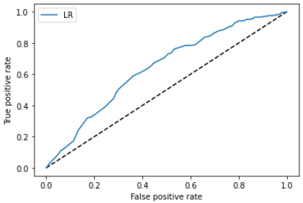
Model results - What impacts reply?
ROC curve for reply
Optimized parameter: Penalty = ‘L2’, C = 0.01
Weighted average class Accuracy 88%, Precision 92%, Recall 94%
Confusion Matrix
 | Predicted Reply | Predicted Not Reply
Replied | 1959 | 140
Not Replied | 179 | 134
AUC score 0.64

Slide 17
Model results - What impacts reply?
Significant Features | Coefficient
message_length_>350*reviews_>20 | 0.5372
contact_me*reviews_>20 | 0.5041
message_length_>350*lead_time_7-15d | 0.2774
contact_me*days_of_stay_1-5d | 0.1630
Message_length_0-50*reviews_0 | -0.4391
Message_length_0-50*days_of_stay_>15d | -0.2673
Long message (350+ char) for listings with more than 20 drives reply
For listings with more than 20 reviews, using contact me channel increases reply rate
For inquiries with lead time between 7-15 days, message length of 350+ characters are more likely to be replied
Inquiries made for 1-5 days of stay are more likely to be replied in Contact Me channel
Sending short messages (<50 char) for no review listings decreases reply rate
Sending short messages (<50 char) for long stays (>15d) decreases reply rate

Slide 18
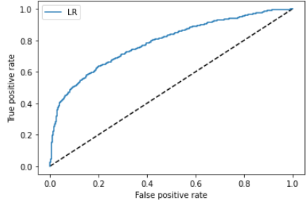
Model results - What impacts acceptance?
Optimized parameter: Penalty = ‘L2’, C = 0.048
Weighted average class Accuracy 77%, Precision 80%, Recall 45%
Confusion Matrix
ROC curve for acceptance
 | Predicted Accept | Predicted Not Accept
Accepted | 1294 | 85
Not Accepted | 411 | 330
AUC score 0.79

Slide 19
Model results - What impacts Acceptance?
Having more than 20 interactions increases the chance of acceptance and having less than 10 interactions decrease it
Inquiries for listings with more reviews are more likely to be accepted
For inquiries made more than 90 days ahead, using Contact Me channel increase its chance to be accepted
For inquiries made more than 90 days ahead, having less than 10 interactions decreases their chance to be accepted
For inquiries with duration between 1- 5 days, having less than 10 interactions decreases their chance to be accepted
Significant Features | Coefficient
interactions_>30 | 0.5806
interactions_21-30 | 0.5122
reviews_>30 | 0.471
contact_me*lead_time_>90d | 0.4061
interactions_1-10 | -1.1965
reviews_0 | -0.8542
lead_time_>90d*interactions_1-10 | -0.6393
days_of_stay_1-5d*interactions_1-10 | -0.5807

Slide 20
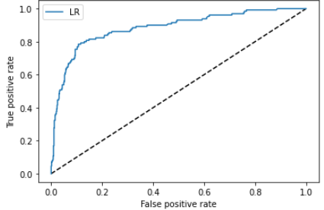
Model results - What impacts booking?
ROC curve for booking
Optimized parameter: Penalty = ‘L2’, C = 0.093
Weighted average class Accuracy 89%, Precision 71%, Recall 54%
Confusion Matrix
 | Predicted Book | Predicted Not Book
Book | 617 | 29
Not Booked | 60 | 70
AUC score 0.88

Slide 21
Model results - What impacts Booking?
Significant Features | Coefficient
interactions_>30 | 0.9256
interactions_21-30 | 0.6503
past_booker | 0.5745
message_length_151-300*interactions_>30 | 0.4228
interactions_1-10 | -1.7255
lead_time_>90d*interactions_1-10 | -0.6576
message_length_0-150*interactions_1-10 | -0.5106
days_of_stay_>15d | -0.5073
Having more than 20 interactions increases the chance of booking and having less than 10 interactions decrease it
Paster bookers are more willing to book make the booking when their inquiries is accepted
When first message length is between 151 - 300 characters, having more than 30 interactions increases the inquiry’s chance to be booked
For inquiries made more than 90 days ahead, having less than 10 interactions decreases their chance to be accepted
When first message length is between 151 - 300 characters, having more than 30 interactions increases the inquiry’s chance to be booked
Inquiries for stays over 15 days are less likely to be booked

Slide 22
Opportunities in increasing the number of successful bookings

Slide 23
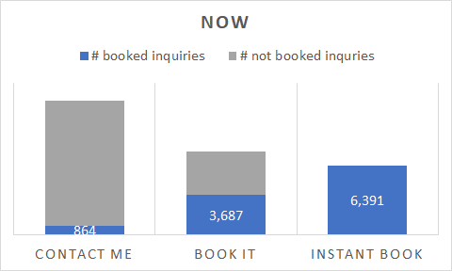
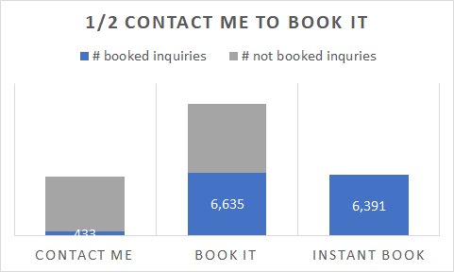
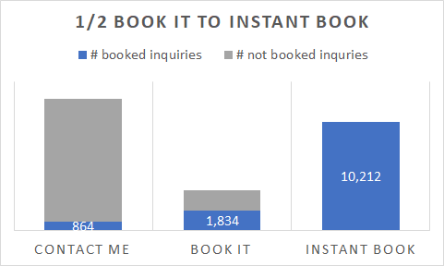
Findings and Opportunities - Channels
The majority (47%) of the inquiries are made in Contact Me channel, but only 7% of them turned into successful bookings, compare to 29% in Book It with success rate of 48% and 24% in Instant Book with success rate of 100%
If Airbnb can shift ½ of the inquiries in Contact Me channel to Book It, we could gain 2517 additional bookings, bringing up the platform’s overall success rate from 41% to 60%
If Airbnb can shift ½ of the inquiries in Book It channel to Instant Book, we could gain 1998 additional bookings, bringing up the platform’s overall success rate from 41% to 49%

Slide 24
Recommendations - Channels
Use Instant Book channel
Encourage usage of Instant Book channel:
Educate new bookers about the process of using Instant Book
Encourage hosts to opt-in for Instant Book channel
Give credit to hosts opted-in for Instant Book channel, streamline the opt-it process
Use Book It channel
If Instant Book is not available, encourage usage of Book It channel

Slide 25
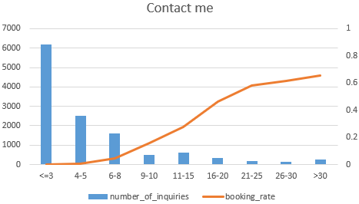
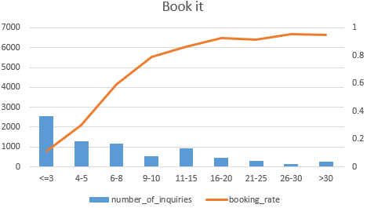
Findings and Opportunities - Interactions
For Contact Me channel
90% of the inquiries (11,166) had no more than 15 interactions, with booking rate of 3%
Inquiries with more than 15 interactions have success rate of 47%, and inquiries with more than 25 interactions have success rate of 62%
For Book It channel
50% of the inquiries (3,844) had no more than 5 interactions, with booking rate of 18%
Inquiries with more than 5 interactions have success rate of 60%, and inquiries with more than 10 interactions have success rate of 87%

Slide 26
Recommendations - Interactions
Encourage interactions between guests and hosts
For Contact Me channel
If 50% of the inquiries that had less than 15 interactions can have more than 15 interactions, Airbnb could gain 1474 extra bookings, bringing up the channel’s overall success rate from 7% to 19%
If 30% of the inquiries that had less than 15 interactions can have more than 25 interactions, Airbnb could gain 1976 extra bookings, bringing up the channel’s overall success rate from 7% to 19%
For Book It channel
If 50% of the inquiries that had less than 5 interactions can have more than 5 interactions, Airbnb could gain 807 extra bookings, bringing up the channel’s overall success rate from 48% to 59%
If 30% of the inquiries that had less than 5 interactions can have more than 10 interactions, Airbnb could gain 796 extra bookings, bringing up the channel’s overall success rate from 48% to 59%

Slide 27
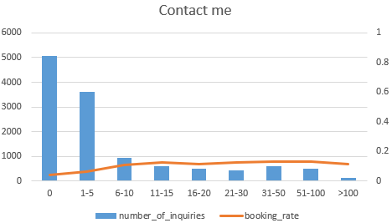
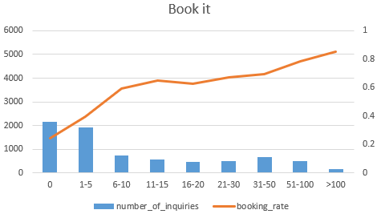
Findings and Opportunities - Reviews
Listings with <5 reviews tend to choose Contact me channel, but listings with more than 5 reviews are evenly distributed among Contact Me and Book It
For Contact Me channel
70% of the inquiries (8,677) were for listings with under 5 reviews and had booking rate of 5%
Having 5+ reviews drives booking rate up to 11%, but booking rate stops increasing after 100+ reviews
25+ interactions increase booking rate up to 64% when review <5
For Book It channel,
63% of the inquiries (4,817) were for listings with under 10 reviews and had booking rate of 36%
Having 10+ reviews drives booking rate up to 65%, and booking rate continues to climb up as number of reviews increases
10+ interactions increase booking rate up to 80% when review <10

Slide 28
Recommendations - Reviews
Encourage reviews for all listings with <5 reviews to drive usage of Book It channel
For Contact Me channel
Encourage guests to leave a review when the listings has less than 5 reviews, but not for listings with 100+ reviews
If 50% of the listings with under 5 reviews can reach 5+ reviews, Airbnb could gain 364 additional bookings, bringing up the channel’s overall success rate from 7% to 10%
For inquiries for listings with under 5 reviews, encourage hosts and guests to have at least 25 interactions
For Book It channel
Encourage guests to leave a review when the listings has less than 10 reviews
If 50% of the listings with under 10 reviews can reach 10+ reviews, Airbnb could gain 698 additional bookings, bringing up the channel’s overall success rate from 48 % to 58%
For inquiries for listings with under 10 reviews, encourage hosts and guests to have at least 10 interactions
For new listings
Promote the listings so that they could have chance to gain reviews and bookings

Slide 29
Findings and Opportunities - User stages
[# of inquiries] reply/acceptance/booking rate* | Contact Me | Book It | Instant Book
New Booker | [8,793] 91%/42%/6% | [4,296] 89%/46%/46% | [2,802] 100%/100%/100%
Past Booker | [4,005] 90%/42%/9% | [4,050] 90%/50%/50% | [3,881] 100%/100%/100%
For new users:
55% of the inquiries made are in Contact Me channel with success rate of 6%
27% of the inquiries in Book It channel with success rate of 46%, and only 18% in Instant Book
Having more than 15 interaction drives booking rate in Contact Me channel to 47%
With the same reply and acceptance rate, new bookers’ booking rate in Contact Me channel is less than past bookers’
New users might not be aware of the last step of booking in Contact Me channel due to low familiarity with the booking process
Recommended listings for new bookers did not fully capture their need due to lack of personalization from prior experience with the platform

Slide 30
Recommendations - User stages
For new users
Encourage usage of Instant Book and Book It channel
For those who chooses Contact Me channel, encourage hosts and guests to have more than 15 interactions
Educate the process of Contact Me channel to new users
Separate search algorithms for new bookers and past booker in that they differ in prior experience with the platform

Slide 31
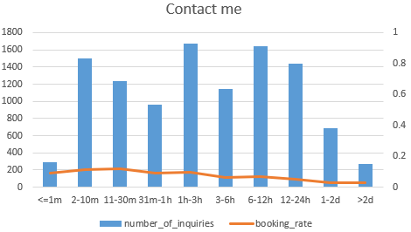
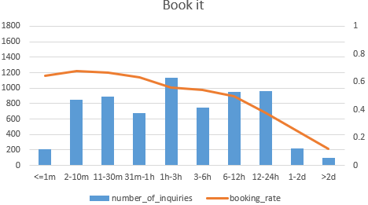
Findings and Opportunities - Reply time
The distribution of reply time are similar for both Contact Me and Book It channel, meaning guests are equally responsive for both channels
Quick response drives bookings for both channels
For Contact Me channel
63% of the inquiries (7,816) had reply time > 30 mins, with booking rate of 7%
Reply time <30 mins drives booking rate up to 12%
For Book It channel
54% of the inquiries (4,107) had reply time > 60 mins, with booking rate of 47%
Reply time <60 mins drives booking rate up to 63%, and reply time <10 mins drives booking rate up to 70%
For Contact Me channel:
Message length of 50-100 char for short lead time (<=7 days) inquiries and 250-300 character messages for long lead time (>7 days) inquiries drives quick reply
For Book It channel:
Message length of 21-50 char for short lead time (<=7 days) inquiries and 400-500 character messages for long lead time (>7 days) inquiries drives quick reply

Slide 32
Recommendations - Reply time
Encourage usage of Book It channel
Encourage guests to give quicker replies
For Contact Me:
Encourage guests to reply within 30 mins
For Book It:
Encourage guests to reply within 60 mins, preferably 10 mins
Encourage users to send proper length messages for different lead time
For Contact Me channel:
Encourage guests to send message of 50-100 char if their are check-ining within 7 days
Encourage guests to send message of 150-300 char if their are check-ining later than 7 days after
For Book It channel:
Encourage guests to send message of 21-50 char if their are check-ining within 7 days
Encourage guests to send message of 400-500 char if their are check-ining later than 7 days after

Slide 33
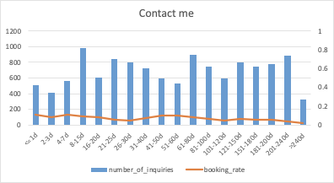
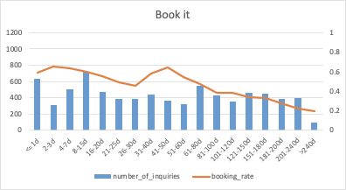
Findings and Opportunities - Lead time
For inquiries with lead time <= 7 days
36% of the inquiries (1,642) were made in Instant Book channel, with booking rate of 100%
32% of the inquiries (6,187) were made in Book It channel, with booking rate of 62%
62% of the inquiries have 5+ reviews
For inquiries with lead time >7 days
50% of the inquiries (10,874) were made in Contact Me channel, with booking rate of 7%
For inquiries made in Contact Me channel
Sending message with 500+ characters drives booking rate up to 10%
Having 30+ interactions drives booking rate up to 68%

Slide 34
Recommendations - Lead time
Encourage reviews for listings with less than 5 reviews to drive <=7 days lead time
For inquiries with >7 days of lead time
Encourage usage of Instant Book and Book It channel
For inquiries already made in Contact Me
Encourage guests to send message with 500+ characters
Encourage guests and hosts to have 30+ interactions

Slide 35
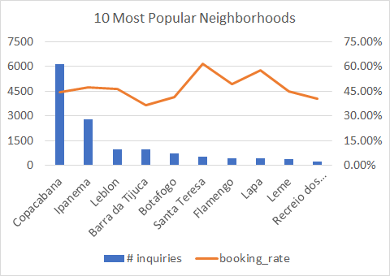
Findings and Opportunities - Neighborhood
For the most popular neighborhoods: Copacabana and Ipanema
6158 and 2766 inquiries were in the two neighborhood with booking rates 45% and 47%
Instant Book usages are less than 30% in both neighborhood
Avg number of reviews are 22 and 27 in the two neighborhood
For the most successful neighborhoods: Santa Teresa and Lapa
546 and 406 inquiries were made for listings in the two neighborhood with booking rates 61% and 58%
Instant Book usages are close to 45% in both neighborhood
Avg number of reviews are 37 and 31 in the two neighborhood
For the worst performance neighborhood: Barra da Tijuca
960 inquiries were made for listings in the neighborhood with booking rate only 37%
Instant Book usage of 20% and Contact Me usage of 53%
Avg number of reviews is only 7

Slide 36
Recommendations - Neighborhood
For the most popular neighborhoods: Copacabana and Ipanema
Encourage Instant Book usage in the neighborhood
Encourage hosts to opt-in for Instant Book channel
For the most successful neighborhoods: Santa Teresa and Lapa
Recruit more hosts rent their properties on the platform
Promote listings in the two neighborhood
For the the worst performance neighborhood: Barra da Tijuca
Encourage Instant Book usage in the neighborhood
Encourage hosts to opt-in for Instant Book channel
Encourage reviews for listings in the neighborhood

Slide 37
Segments doing well v.s. not well

Slide 38
Segments doing well v.s. not well
Segments doing well:
Instant Book channel:
Success rate 100%
Average # interactions per inquiries 11
Inquiries with 15+ interactions:
Success rate 75%
Listing with 30+ reviews:
Success rate 73%
Average # interactions per inquiries 9
Past Booker:
Success rate 53%
Average # interactions per inquiries 9
Not well:
Contact Me channel:
Success rate 7%
Average # interactions per inquiries 6
Inquiries with <3 interactions:
Success rate 12%
Listing with 0 reviews:
Success rate 28%
Average # interactions per inquiries 6
New Booker:
Success rate 33%
Average # interactions per inquiries 8

Slide 39
Challenges of matching supply and demand

Slide 40
Challenges of matching supply and demand
Demand
Purpose of travel
Tourists may want to stay closer to local attractions
Business travellers may value accessibility to their meeting locations and the airport
Lead to difficulties in matching users’ exactly needs
Logged-out users/new users
No information on prior behaviors and demographic characteristics
Lead to difficulties in personalizing recommendations for users
Supply
Demand fulfillment
Unlike usual goods, it is hard to find what kind of listings has a considerable demand that has not been fulfilled
Lead to potential lack of supply of such listings

Slide 41
Additional research methods

Slide 42
Additional research methods
Add travel purpose (family, business, etc) to the search criteria and use A/B test to determine whether it drives more bookings
Conduct survey to obtain new/logged-off users’ demographic information and preferences to guide listing recommendation and use A/B test to find whether it drives more bookings
Develop demand fulfilled evaluation methods to manage supply and use A/B test to determine whether it drives more bookings

